Slide 1
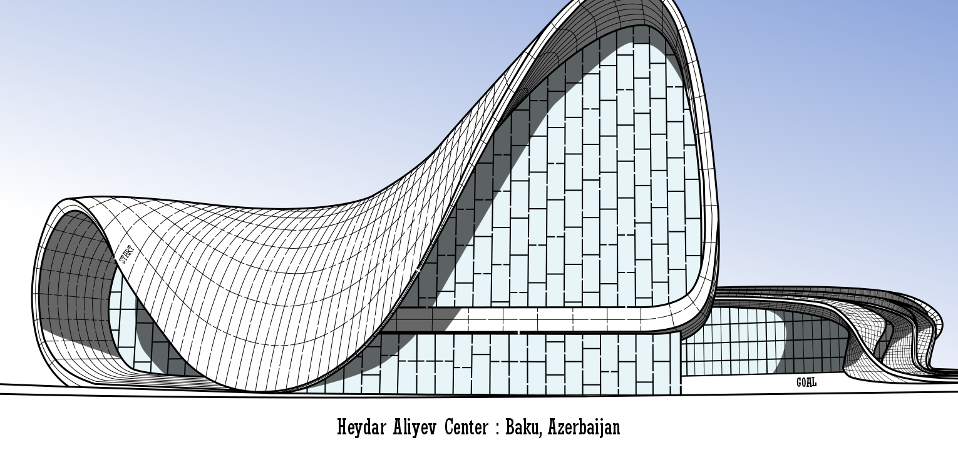


AzSat The Republic of Azerbaijan APRSAF CanSat Competition
Presenter: Toghrul Guluzade

Slide 2
Mission Concept – CanSat as a Planetary Probe
Released from a predetermined altitude
Lands safely using a parachute-based system
Operates autonomously on the surface
Power Sustainability:
Equipped with solar panels
Supports extended operation time for long-term missions

Slide 3
Applications in Terrestrial Environments
Accesses hazardous or hard-to-reach areas
Volcanic zones
Disaster sites
Polar regions
Collects environmental data over long durations
Helps avoid human risk in dangerous conditions

Slide 4
Potential for Planetary Missions
Can operate on planetary surfaces
Gathers data on:
Atmospheric conditions
Surface weather
Environmental parameters

Slide 5
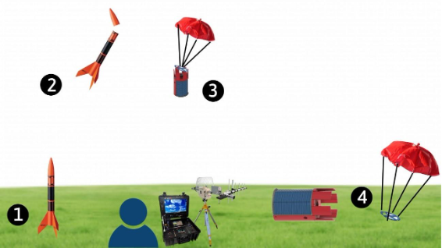
Mission Lifecycle

Slide 6
Advanced Electronics System Overview
Communication
Sensor data acquisition
Actuation
Energy management

Slide 7
Communication & Control
Component | Function
Arduino Nano | Main controller managing sensors, logic, and communication
LoRa RA-01 | Sends telemetry to ground station; receives control commands
Arduino Uno | Ground station MCU for real-time data display and command relay
Logic Shifter | Ensures safe voltage compatibility between 3.3V LoRa and 5V Arduino

Slide 8
Sensor & Data Systems - 2
🌡️ Temperature
💧 Humidity
🌬️ Pressure & Altitude
☀️ Light Intensity
🧭 3-Axis Accelerometer & Gyroscope

Slide 9
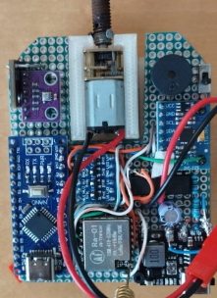
Custom PCB Integration
4
1
We designed and manufactured a custom PCB
It allowed tight integration of all electronics
Reduced wiring complexity and improved durability
Here is the following components
1. Light Sensor
2. BME 280
3. N20 dc Motor
4. Buzzer
5. MPU 6050
6. Logic Shift Register
7. Lora RA01 Transceiver
8. L298M motor Driver
9. Voltage Sensor
10. Arduino Nano
11. TP4056 Step Up voltage
3
2
5
6
8
9
10
11
7

Slide 10
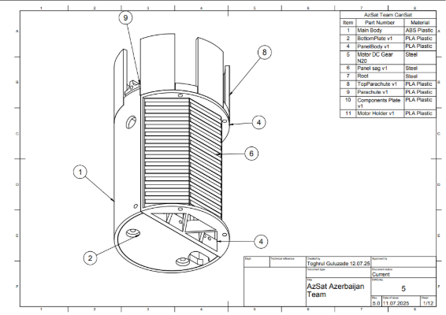
Mechanical Design -1

Slide 11
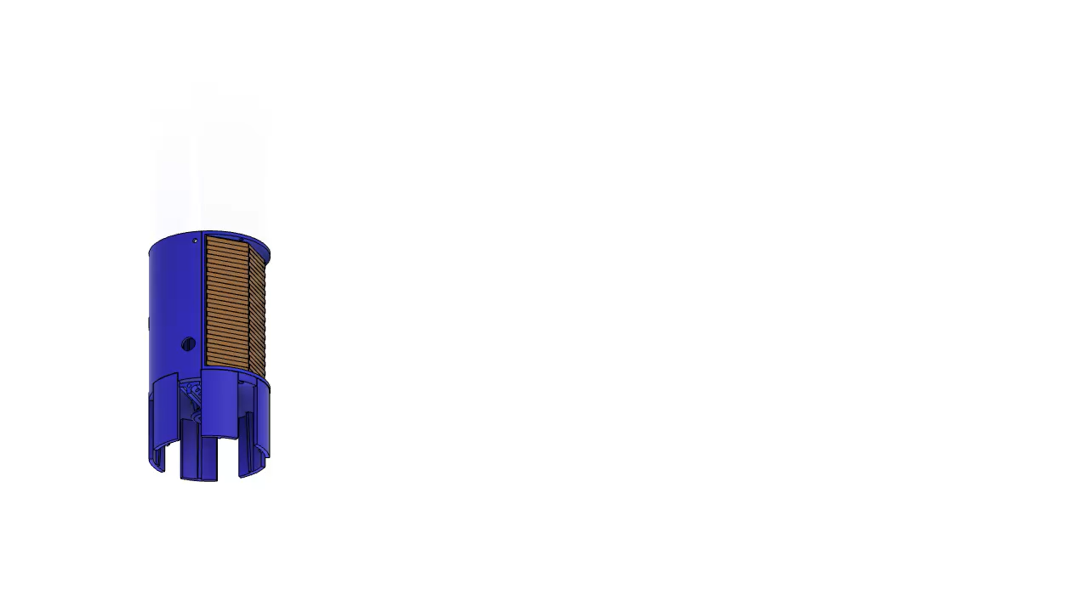
Explosion Simulation of our CanSat

Slide 12
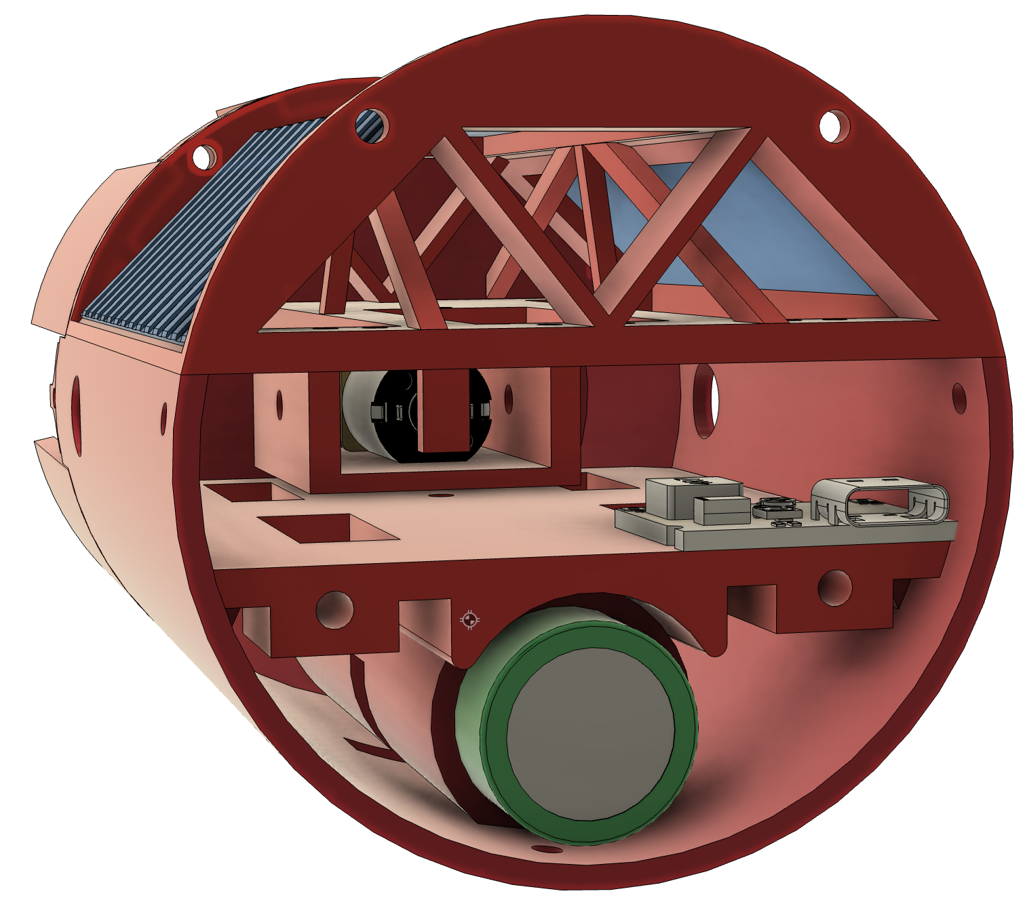
Auto-Rotation & Passive Stabilization
Low center of gravity enables passive self-righting
Solar panels consistently face upward after landing
No active reorientation system needed
Reliable on uneven terrain and rough landings
Center of Mass

Slide 13
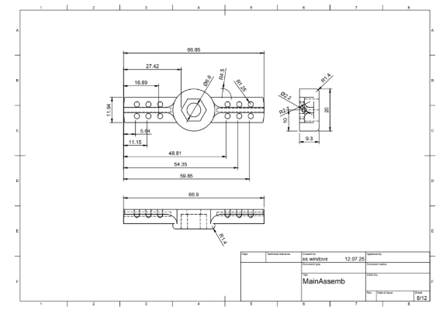
Mechanical Design - 2

Slide 14
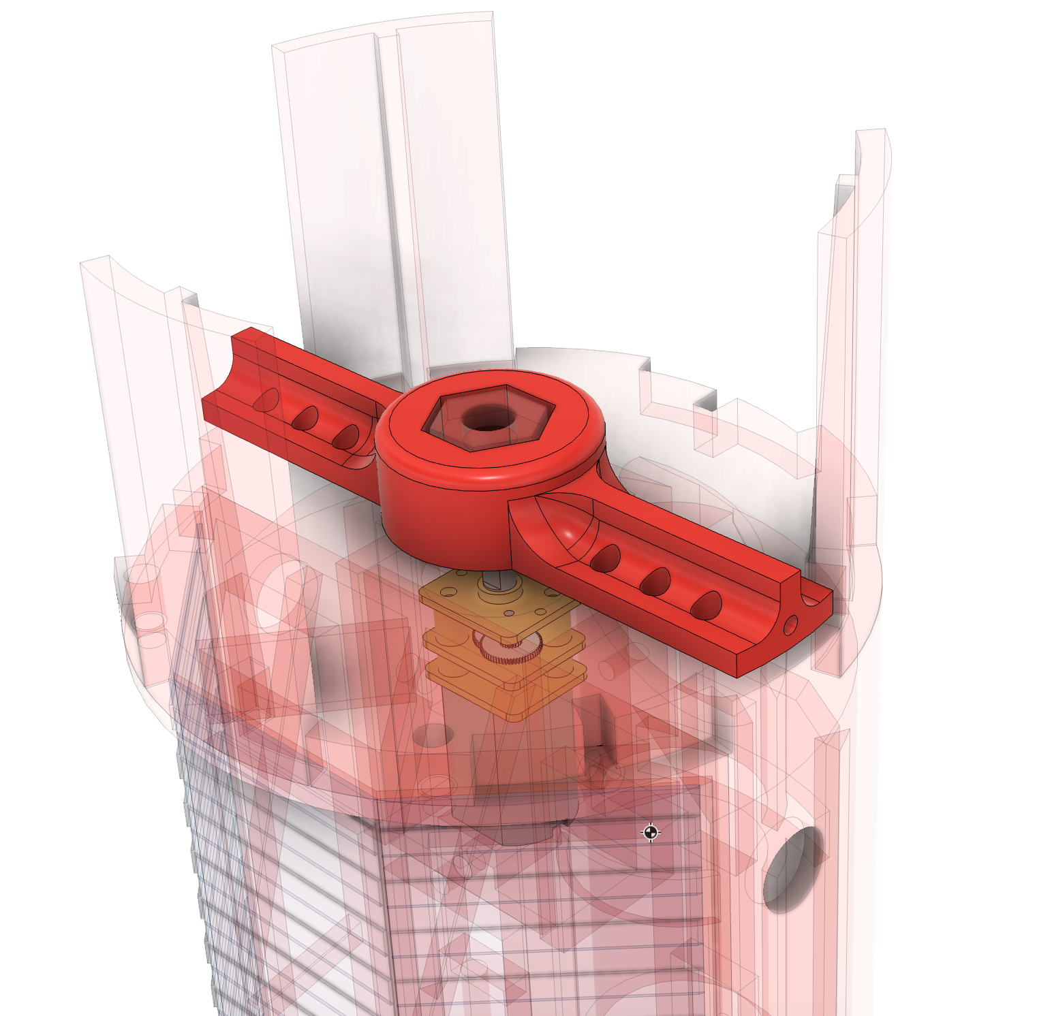
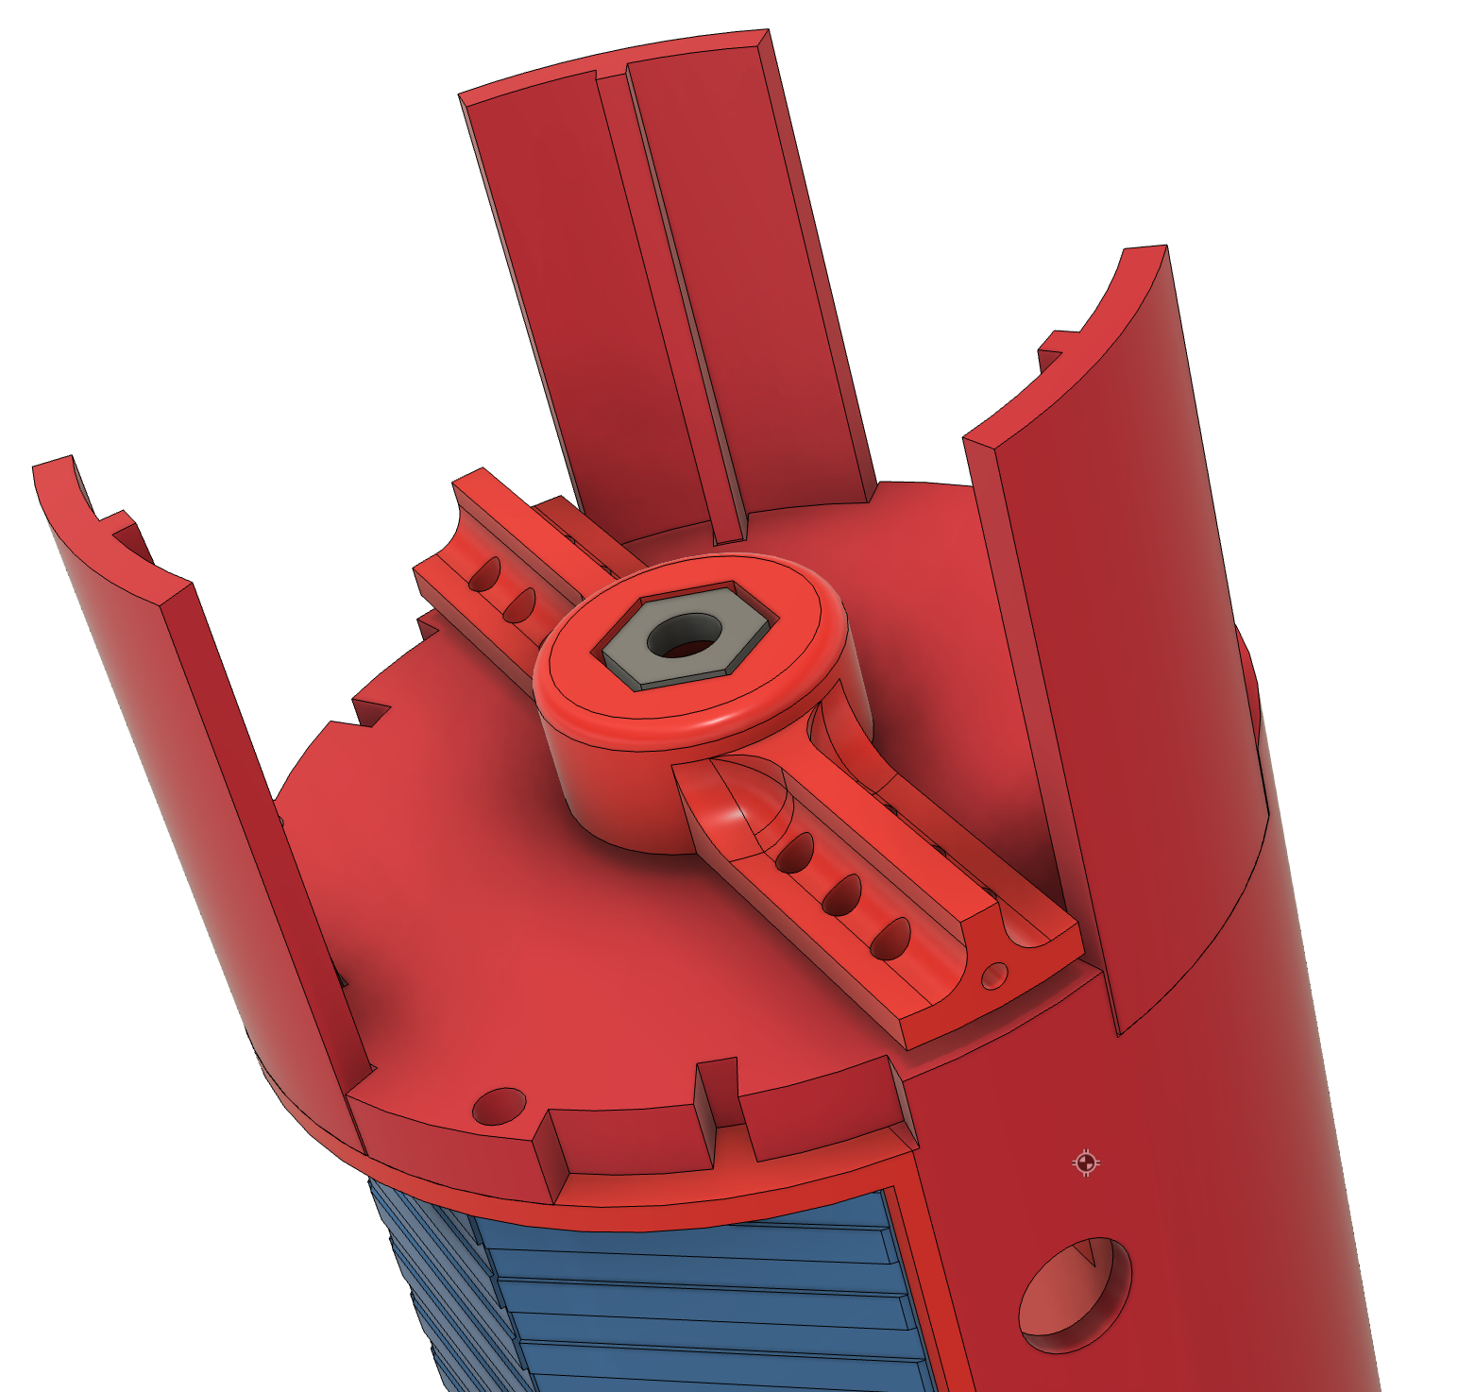
Prachute connection

Slide 15
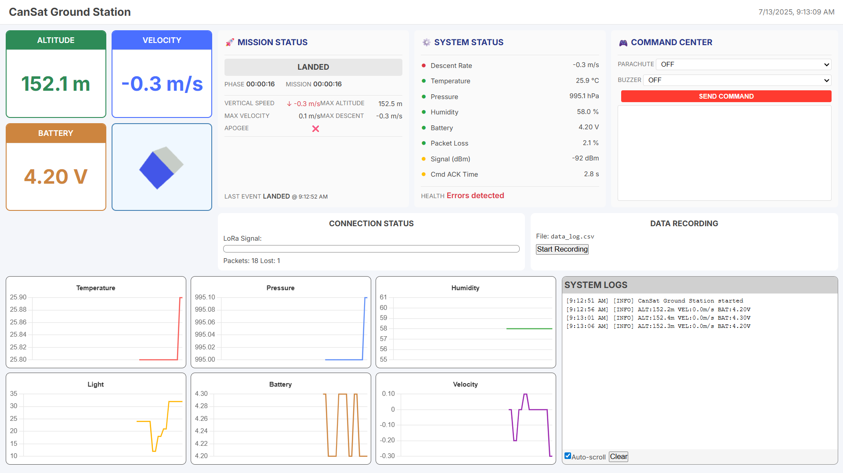

Slide 16
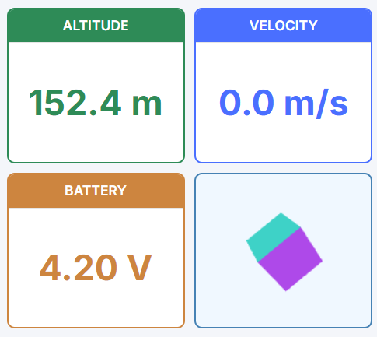

Slide 17
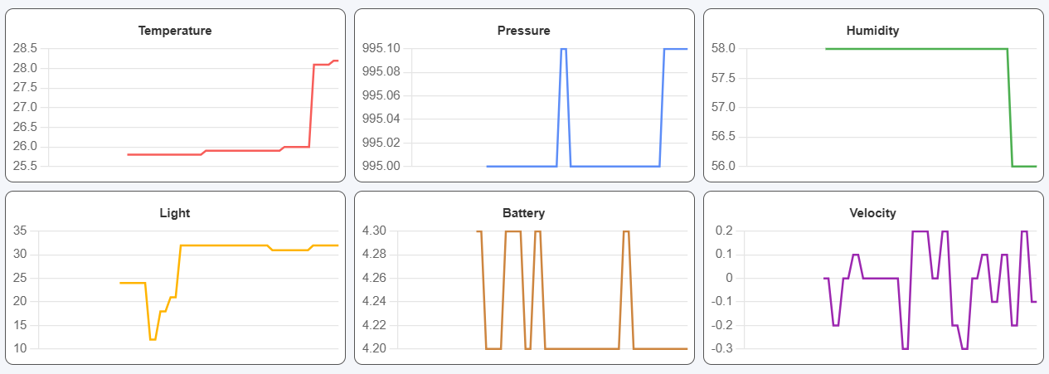

Slide 18
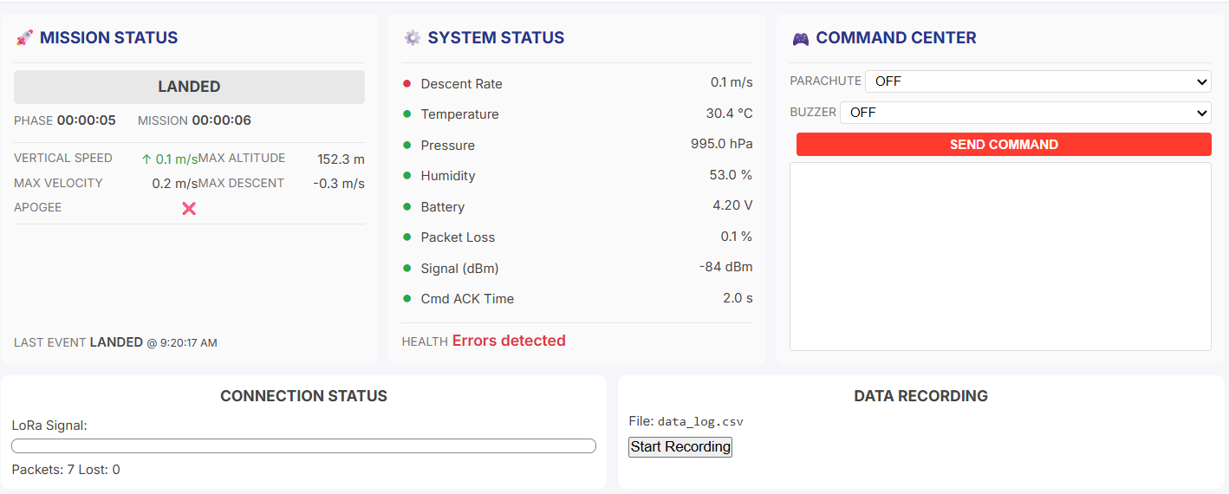

Slide 19
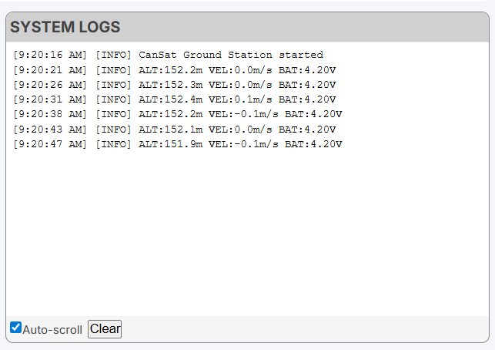

Slide 20
What do we aim for?
✅ Meet size & weight constraints (124 mm height, 66 mm diameter, 250–300g)
1
✅ Survive all mission phases intact
2
✅ Smooth deployment with parachute and safe descent
3
✅ Land upright with solar panels facing sunlight
4
✅ Parachute detachment to prevent post-landing drag
5
✅ Stable data collection with onboard sensors
6
✅ Continuous two-way communication with ground station
7

Slide 21
What We Achieved
✅ Successful launch, smooth descent with fully deployed parachute
✅ Landing occurred as planned — heavy side down, solar panels exposed
✅ Structure remained fully intact
✅ Parachute cut system activated, though lines tangled; ☑️ May detach over time via wind assistance, as designed
✅ All electronics survived and continued operating
⚠️ Limited testing time post-landing due to flight constraints.

Slide 22
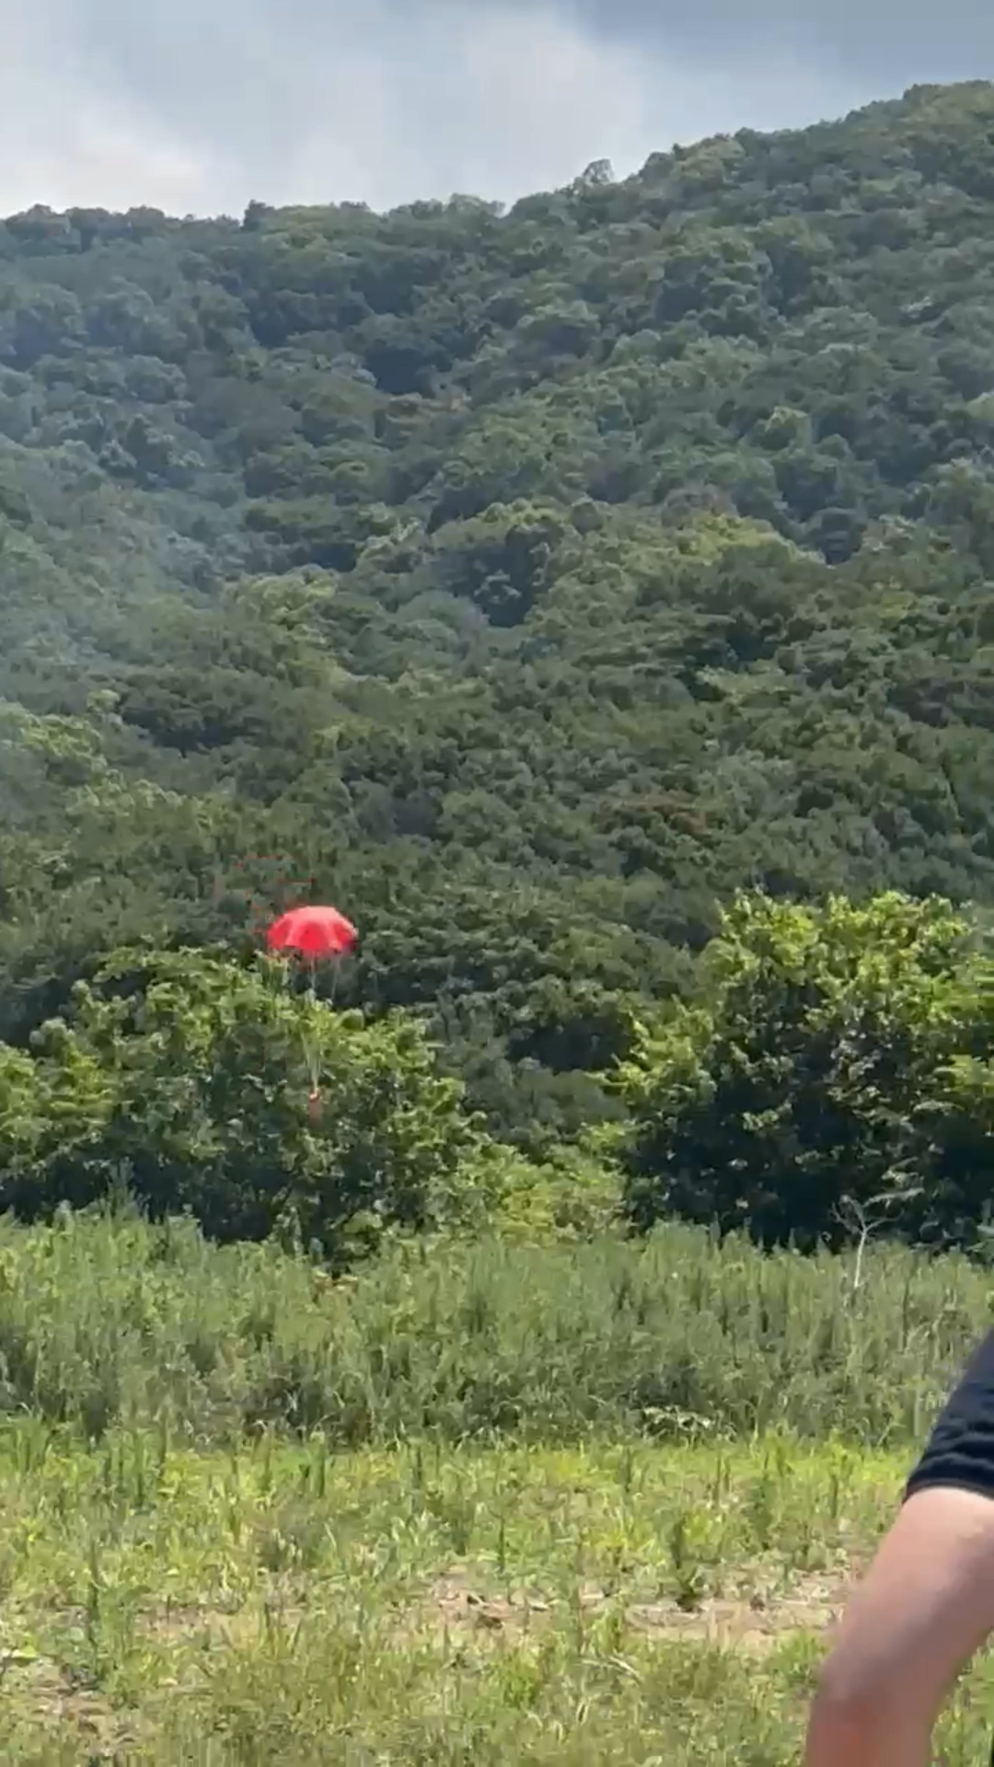
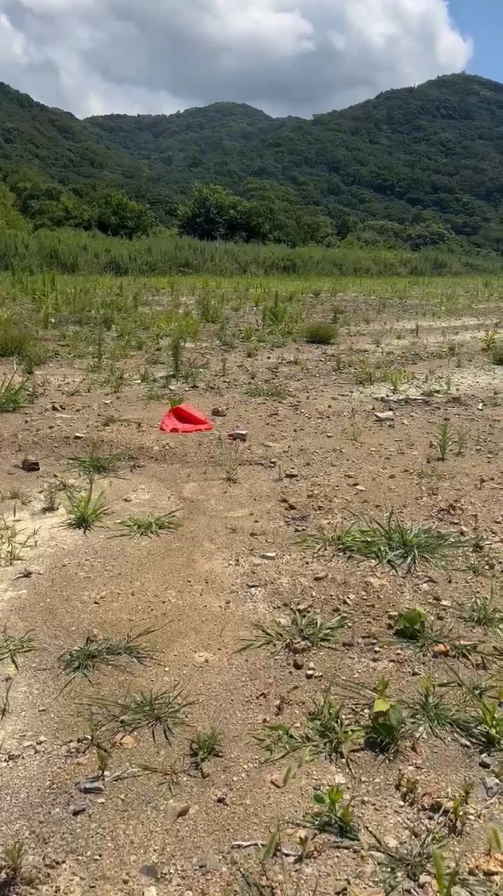

Slide 23
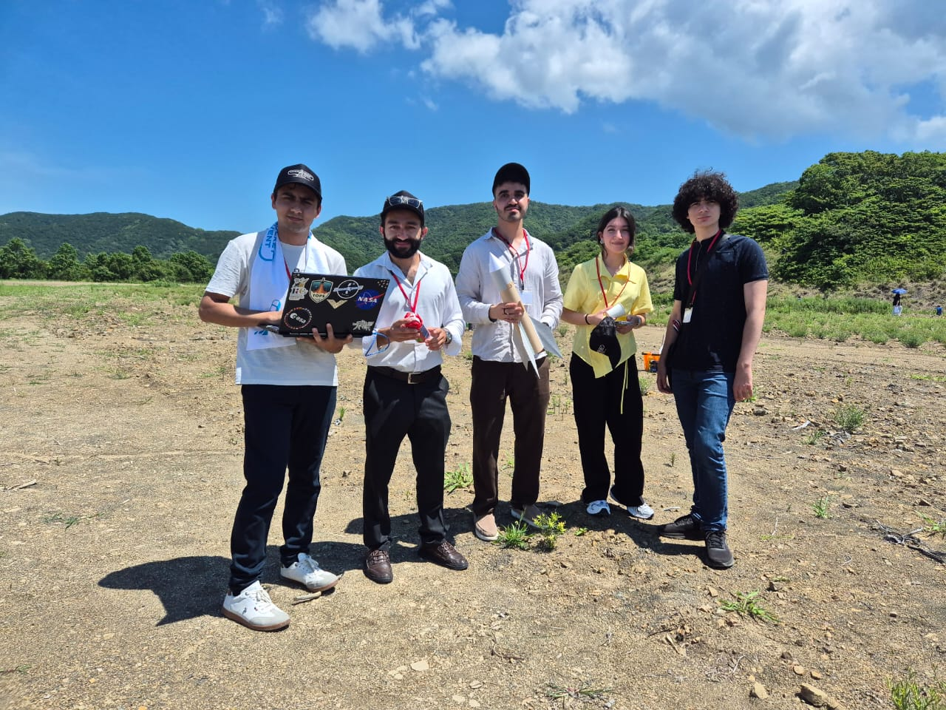
Thanks for your attention

